Slide 1
Review: Chapters 5 + 6
Fallacies of relevance
Fallacies of insufficient evidence
1. Personal attack
2. Attacking the motive
3. Look who’s talking
4. Two wrongs make a right
5. Scare tactic
6. Appeal to pity
7. Bandwagon argument
8. Straw man
9. Red herring
10. Equivocation
11. Begging the question
1. Inappropriate appeal to authority
2. Appeal to ignorance
3. False alternatives
4. Loaded question
5. Questionable cause
6. Hasty generalization
7. Slippery slope
8. Weak analogy
9. Inconsistency

Slide 2
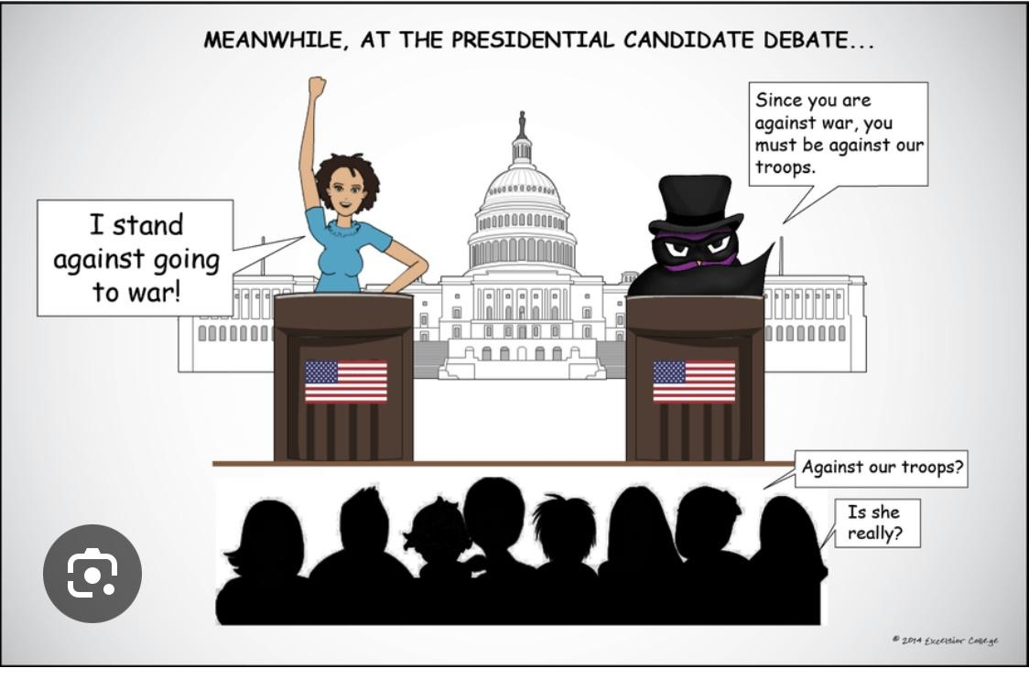
Fallacy of insufficient evidence
Input
Fallacy type: False alternatives
Source: https://shorturl.at/W3Vhx
Notes:
Phan Tấn Phong - BAFNIU21535
Trương Thị Vân Anh - ENENIU22143
Nguyễn Ngọc Anh Thư - ENENIU22154
Nguyễn Tấn Dũng - ITITIU21185
Lê Nguyễn Gia Anh - ENENIU22140
Nguyễn Lê Ngọc Minh - ENENWE22344
Lê Anh Thy - ENENWE21409
Dương Minh Nguyệt - ENENIU22101
---
Dương Thuỵ Hồng Ân - BEBEIU22274
Đặng Thị Tuyết Như - BABAIU22277
Nguyễn Văn Kiên - BABAWE22214
Đặng Khánh Huyền - MAMAIU22066
Nguyễn Hoàng Nam Phương - BABAWE22409
Huỳnh Quốc Bảo - MAMAIU22082
Trần Ngọc Anh Thơ - MAMAIU22074
Nguyễn Thị Kim Phụng - BABAWE22355

Slide 3
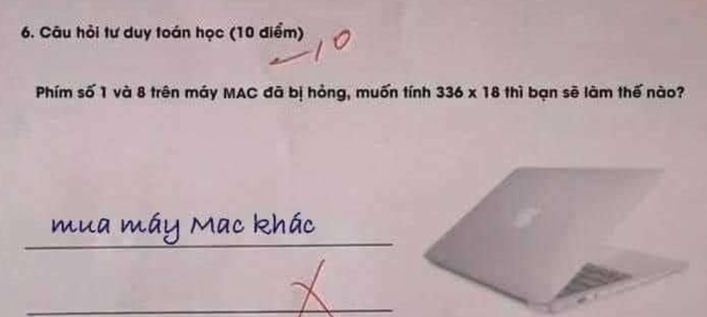
Fallacy of insufficient evidence
Input
Fallacy type: Red herring
Source: pinterest

Slide 4

Fallacy of insufficient evidence
Input:
Fallacy type: Post hoc fallacy
Source: https://hay1.vn/people/Thich-Chan-Quang-9dg6C0
Notes:
Duy Do Minh

Slide 5

Fallacy of insufficient evidence
Input
Fallacy type: mere correlation
Source: facebook
Notes:
Duy Do Minh

Slide 6
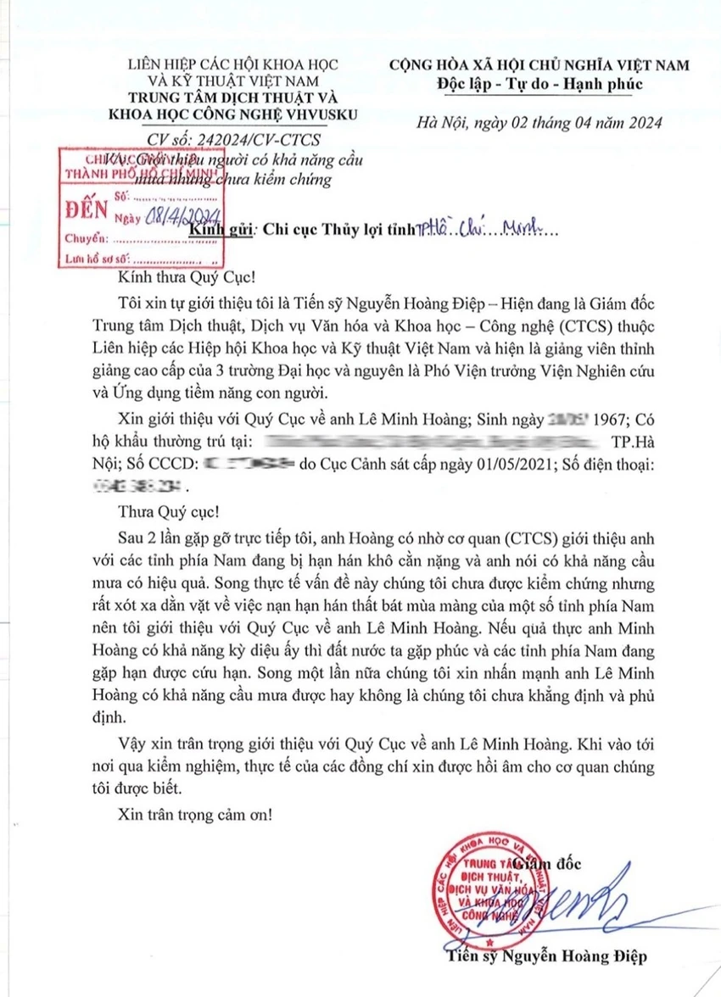
Notes:
https://plo.vn/lam-ro-thong-tin-lap-dan-cau-mua-va-khi-nao-tphcm-co-mua-post785472.html

Slide 7
Chapter 7
Analyzing Arguments

Slide 8
Content
Part 1: Diagramming short arguments
Part 2: Standardizing extended arguments
Objectives:
To see the logical structures of short arguments
To add clarity to long and confusing arguments

Slide 9
Part 1
Diagramming Short Arguments

Slide 10
Arguments – Review
Arguments consist of premises and conclusions.
Premises and conclusions are statements.

Slide 11
Arguments – Review
Premise indicator words:
since, because, for, given that, seeing that, considering that, inasmuch as, as, in view of the fact that, as indicated by, judging from, on account of
Conclusion indicator words:
therefore, thus, hence, consequently, so, accordingly, it follows that, for this reason, that is why, which shows that, wherefore, this implies that, as a result, this suggests that, this being so, we may infer that, etc.

Slide 12
Diagramming short arguments
Argument
It is essential that students actively cooperate with their teacher in an online class because students are only present as voices and texts, the teacher cannot check on them individually to ensure they are studying, and their enthusiasm provides the teacher with a supportive feeling.

Slide 13
Diagramming short arguments (cont)
Step 1: Identify all premise and/or conclusion indicators. Also, identify the irrelevant or redundant statements (if any).
It is essential that students actively cooperate with their teacher in an online class because students are only present as voices and texts, the teacher cannot check on them individually to ensure they are studying, and their enthusiasm provides the teacher with a supportive feeling.

Slide 14
Diagramming short arguments (cont)
Step 2: Number the statements consecutively as they appear in the argument and omit the irrelevant or redundant ones.
It is essential that students actively cooperate with their teacher in an online class
students are only present as voices and texts
the teacher cannot check on them individually to ensure they are studying
their enthusiasm provides the teacher with a supportive feeling

Slide 15
Diagramming short arguments (cont)
Step 3: Arrange the numbers with the premises placed above the conclusion(s) they claim to support.
2 3 4
1

Slide 16
Diagramming short arguments (cont)
Step 4: Use arrows to mean ‘is offered as evidence for’ to show the relationship of argument support.
2 3 4
1
2, 3, and 4 offer independent support for the conclusion.

Slide 17
Independent vs. Linked support
Diagramming short arguments (cont)
Example 1
1) Nick doesn’t own a car.
2) He has poor vision.
3) He lives near the stadium.
4) So, Nick probably won’t drive a car to the game.
Example 2
1) No student skipping Chapter 7 can do well on the writing test.
2) Henry skipped Chapter 7.
3) So, Henry couldn’t do well on the writing test.

Slide 18
Diagramming short arguments (cont)
Independent support: does not weaken or destroy any other premise but offers less support for the conclusion
1 2 3
4
Linked support: works cooperatively with another premise to support the conclusion
1 + 3
2

Slide 19
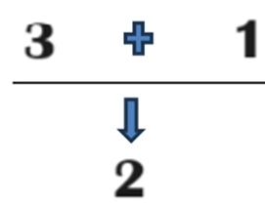
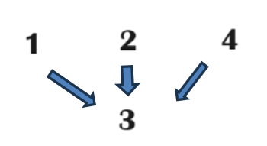
Linked or Independent support?
1. Amy is a marathon runner (1). She is very fit (2), given that if a person runs marathons, then he/she is very fit (3).
Linked support
2. I saw Tom in the Biotech lab yesterday (1) and last week he was reading a textbook of Chemistry in the library (2). I thought he can be a BT student (3) because he often discusses topics of life science (4).
Independent support

Slide 20
Other kinds of support
Jim is an elderly man.
So, Jim probably doesn’t like hip-hop music.
So, Jim probably won’t be going to the underground music show tonight.
1
2
3

Slide 21
Other kinds of support (cont)
Example
Most IU students are BA majors, and An is an IU student. Thus, An is probably a BA major. Therefore, An probably supports the contest for potential business leaders, because most BA majors support the contest for potential business leaders.
Most IU students are BA majors
An is an IU student
An is probably a BA major
An probably supports the contest for potential business leaders
most BA majors support the contest for potential business leaders

Slide 22
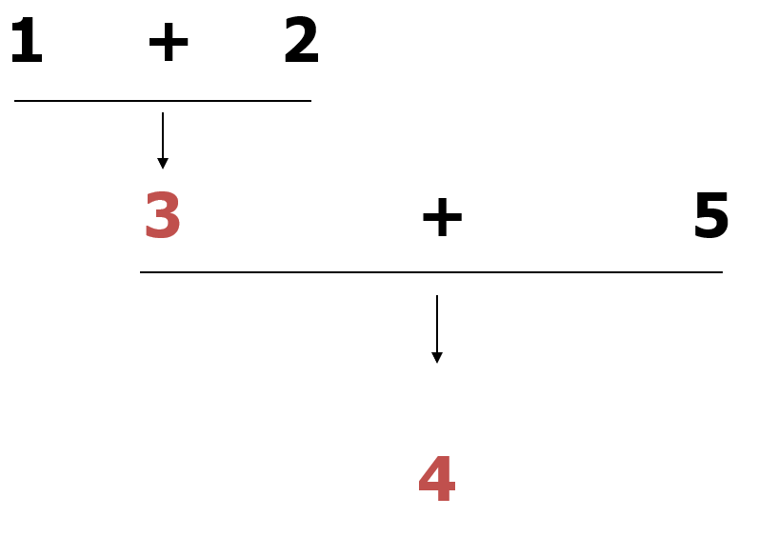
Other kinds of support (cont)
Example
Most IU students are BA majors, and An is an IU student. Thus, An is probably a BA major. Therefore, An probably supports the contest for potential business leaders, because most BA majors support the contest for potential business leaders.
Most IU students are BA majors
An is an IU student
An is probably a BA major
An probably supports the contest for potential business leaders
most BA majors support the contest for potential business leaders

Slide 23
Other kinds of support (cont)
Cheating is wrong. First, it will lower your self-respect, because you can never be proud of anything you got by cheating. Second, cheating is a lie because it deceives other people into thinking you know more than you do. Third, cheating violates the teacher’s trust that you will do your own work. Fourth, cheating is unfair to all the people who aren’t cheating. Finally, if you cheat in school now, you’ll find it easier to cheat in other situations later in life – perhaps even in your closest personal relationships.
cheating is wrong
it will lower your self-respect
because you can never be proud of anything you got by cheating
cheating is a lie
because it deceives other people into thinking you know more than you do
cheating violates the teacher’s trust that you will do your own work
cheating is unfair to all the people who aren’t cheating
if you cheat in school now, you’ll find it easier to cheat in other situations later in life – perhaps even in your closest personal relationships

Slide 24
Other Kinds of Support
1) cheating is wrong
2) it will lower your self-respect
3) because you can never be proud of anything you got by cheating
4) cheating is a lie
5) because it deceives other people into thinking you know more than you do
6) cheating violates the teacher’s trust that you will do your own work
7) cheating is unfair to all the people who aren’t cheating
8) if you cheat in school now, you’ll find it easier to cheat in other situations later in life – perhaps even in your closest personal relationships

Slide 25
Other Kinds of Support
1) cheating is wrong
2) it will lower your self-respect
3) because you can never be proud of anything you got by cheating
4) cheating is a lie
5) because it deceives other people into thinking you know more than you do
6) cheating violates the teacher’s trust that you will do your own work
7) cheating is unfair to all the people who aren’t cheating
8) if you cheat in school now, you’ll find it easier to cheat in other situations later in life – perhaps even in your closest personal relationships
3
5
2
4
6
7
8
1

Slide 26
Review: Tips on Diagramming short arguments
Pay close attention to premise and conclusion indicators.
Find the main conclusion and analyze it carefully for controlling word(s).
Number the statements and/or expressions of cause-effect.
Note: Compound and complex sentences contain two or more separate statements.
4. Treat conditional statements (if-then) and disjunctive
statements (either-or) as single statements.
5. Don’t diagram irrelevant statements.
6. Don’t diagram redundant statements.

Slide 27
Diagram the argument
Two teenagers saw the movie, "Natural Born Killers," so they went out on a serial killing. A number of teenagers have committed violence at schools as a result of their many hours’ playing video games filled with murder and violence. We must have some stricter controls on the content of entertainment viewed by teenagers.
(1) two teenagers saw the movie, "Natural Born Killers"
(2) they went out on a serial killing
(3) a number of teenagers have committed violence at schools
(4) as a result of their many hours’ playing video games filled with murder & violence
(5) we must have some stricter controls on the content of entertainment viewed by teenagers

Slide 28
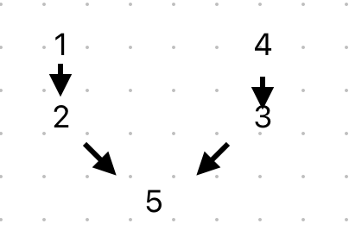
Diagram the argument
Two teenagers saw the movie, "Natural Born Killers," so they went out on a serial killing. A number of teenagers have committed violence at schools as a result of their many hours’ playing video games filled with murder and violence. We must have some stricter controls on the content of entertainment viewed by teenagers.
(1) two teenagers saw the movie, "Natural Born Killers"
(2) they went out on a serial killing
(3) a number of teenagers have committed violence at schools
(4) as a result of their many hours’ playing video games filled with murder and violence
(5) we must have some stricter controls on the content of entertainment viewed by teenagers

Slide 29
Diagram the argument
We cannot ignore the disastrous effects of TV on children. It appears to shorten the attention span of the young. It also seems to erode their linguistic powers and ability to handle mathematical symbolism. Television also changes their character in a negative way because violent programs increasingly make them impatient and cruel. More seriously, television opens all of society's secrets and taboos, thus it erases the dividing line between childhood and adulthood.
We cannot ignore the disastrous effects of TV on children.
It appears to shorten the attention span of the young.
It also seems to erode their linguistic powers and ability to handle mathematical symbolism.
Television also changes their character in a negative way
Violent programs increasingly make them impatient and cruel.
More seriously, television opens all of society's secrets and taboos.
It erases the dividing line between childhood and adulthood.

Slide 30
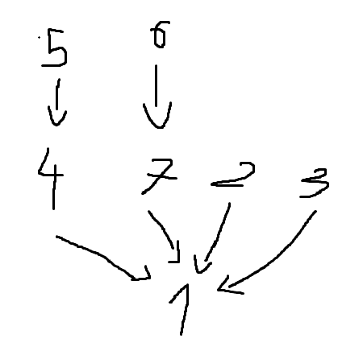
Diagram the argument
We cannot ignore disastrous effects of TV on children. It appears to shorten the attention span of the young. It also seems to erode their linguistic powers and ability to handle mathematical symbolism. Additionally, television changes their character in a negative way because violent programs increasingly make them impatient and cruel. More seriously, television opens all of society's secrets and taboos, thus it erases the dividing line between childhood and adulthood.
(1) We cannot ignore disastrous effects of TV on children.
(2) It appears to shorten the attention span of the young.
(3) It also seems to erode their linguistic powers and ability to handle mathematical symbolism.
(4) Additionally, television changes their character in a negative way.
(5) Violent programs increasingly make them impatient and cruel.
(6) More seriously, television opens all of society's secrets and taboos.
(7) It erases the dividing line between childhood and adulthood.
Bui Cong Vinh

Slide 31
Task: Number the statements, clarify the references and diagram the following argument:
President Donald Trump on the election result (November 8, 2020)
“Beginning Monday, our campaign will start prosecuting our case in court to ensure election laws are fully upheld and the rightful winner is seated. The American People are entitled to an honest election: counting all legal ballots, and not counting any illegal ballots. This is the only way to ensure the public has full confidence in our election. It remains shocking that the Biden campaign refuses to agree with this basic principle and wants ballots counted even if they are fraudulent, manufactured, or cast by ineligible or deceased voters. Only a party engaged in wrongdoing would unlawfully keep observers out of the count room and then fight in court to block their access.”
https://apnews.com/article/transcript-statement-donald-trump-

Slide 32
Task: Number the statements, clarify the references and diagram the following argument:
President Donald Trump on the election result (November 8, 2020)
Beginning Monday, our campaign will start prosecuting our case in court to ensure election laws are fully upheld and the rightful winner is seated.
The American People are entitled to an honest election: counting all legal ballots, and not counting any illegal ballots.
(This is the only way to ensure the public has full confidence in our election).
The Biden campaign refuses to agree with this basic principle.
(The Biden campaign) wants ballots counted even if they are fraudulent, manufactured, or cast by ineligible or deceased voters.
Only a party (Biden’s Democratic Party) engaged in wrongdoing would unlawfully keep observers out of the count room and then fight in court to block their access.
5
6
2
+
4
1

Slide 33
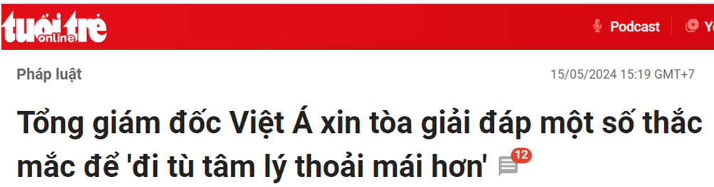
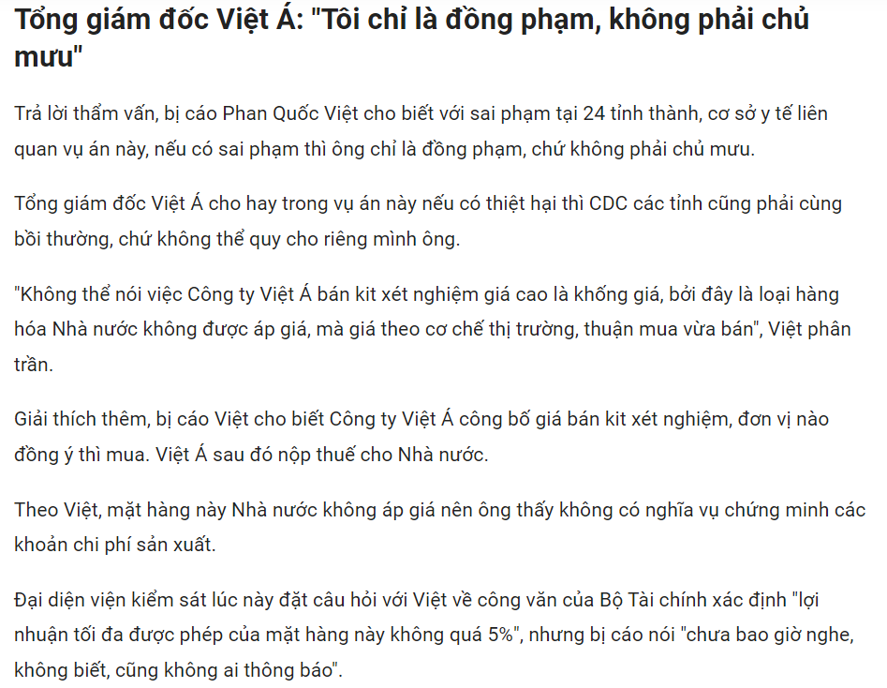
Notes:
https://tuoitre.vn/tong-giam-doc-viet-a-xin-toa-giai-dap-mot-so-thac-mac-de-di-tu-tam-ly-thoai-mai-hon-20240515144846389.htm

Slide 34
Nummbering and removing the redundant statements
(1) Trả lời thẩm vấn, bị cáo Phan Quốc Việt cho biết với sai phạm tại 24 tỉnh thành, cơ sở y tế liên quan vụ án này, nếu có sai phạm thì ông chỉ là đồng phạm, chứ không phải chủ mưu.
(2) Tổng giám đốc Việt Á cho hay trong vụ án này nếu có thiệt hại thì CDC các tỉnh cũng phải cùng bồi thường, chứ không thể quy cho riêng mình ông.
(3) “Không thể nói việc Công ty Việt Á bán kit xét nghiệm giá cao là khống giá bởi (4) đây là loại hàng hóa Nhà nước không được áp giá mà (5) giá theo cơ chế thị trường, thuận mua vừa bán“
(6) Việt Á sau đó nộp thuế cho Nhà nước.
(4)Theo Việt, mặt hàng này Nhà nước không áp giá nên (7) ông thấy không có nghĩa vụ chứng minh các khoản chi phí sản xuất.
Notes:
https://tuoitre.vn/tong-giam-doc-viet-a-xin-toa-giai-dap-mot-so-thac-mac-de-di-tu-tam-ly-thoai-mai-hon-20240515144846389.htm

Slide 35
Diagraming the argument
(1) Trả lời thẩm vấn, bị cáo Phan Quốc Việt cho biết với sai phạm tại 24 tỉnh thành, cơ sở y tế liên quan vụ án này, nếu có sai phạm thì ông chỉ là đồng phạm, chứ không phải chủ mưu.
(2) Tổng giám đốc Việt Á cho hay trong vụ án này nếu có thiệt hại thì CDC các tỉnh cũng phải cùng bồi thường, chứ không thể quy cho riêng mình ông.
(3) “Không thể nói việc Công ty Việt Á bán kit xét nghiệm giá cao là khống giá bởi (4) đây là loại hàng hóa Nhà nước không được áp giá mà (5) giá theo cơ chế thị trường, thuận mua vừa bán“
(6) Việt Á sau đó nộp thuế cho Nhà nước.
(4)Theo Việt, mặt hàng này Nhà nước không áp giá nên (7) ông thấy không có nghĩa vụ chứng minh các khoản chi phí sản xuất.
4
4
5
3
6
7
2
1
Notes:
https://tuoitre.vn/tong-giam-doc-viet-a-xin-toa-giai-dap-mot-so-thac-mac-de-di-tu-tam-ly-thoai-mai-hon-20240515144846389.htm

Slide 36
Part 2
Summarizing extended arguments

Slide 37
What does an extended argument look like?
Professor Jack W. Meiland, offering advice to college students:
There is one question which you should not ask, nor feel any temptation to ask, your instructor. That question is: “Will this be on the exam?” This question infuriates many instructors, and rightly so. For this question indicates that your main interest is in getting through the course with a good grade rather than in learning what the instructor has to teach. It is insulting to the teacher who has worked hard to put you in a position to appreciate the material - its intrinsic interest, its subtlety, its complexity.

Slide 38
Argument standardization
Argument standardization = a method for summarizing extended arguments that accurately and logically restates the main points.
Two important skills of argument analysis:
1. Paraphrasing
2. Finding missing premises and conclusions

Slide 39




Characteristics of a good paraphrase
accurate
clear
concise
charitable
Notes:
39

Slide 40
Skill 1. Paraphrasing
1. Be accurate: don’t misrepresent information
Example: Europe has a set of primary interests, which to us have no, or a very remote relation to ours.
(1). Europe’s vital interests are totally different than ours.
(2). Europe has a set of vital interests which are of little or no concern to us.
Comment: (1) changes the original meaning; (2) is an accurate paraphrase.
Notes:
(

Slide 41

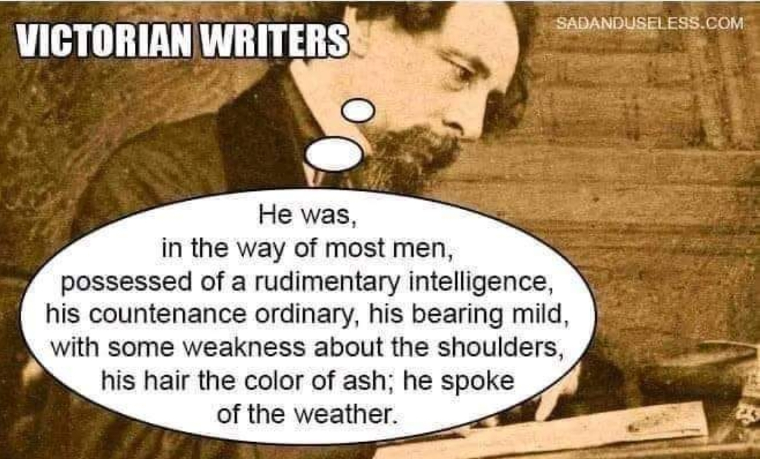
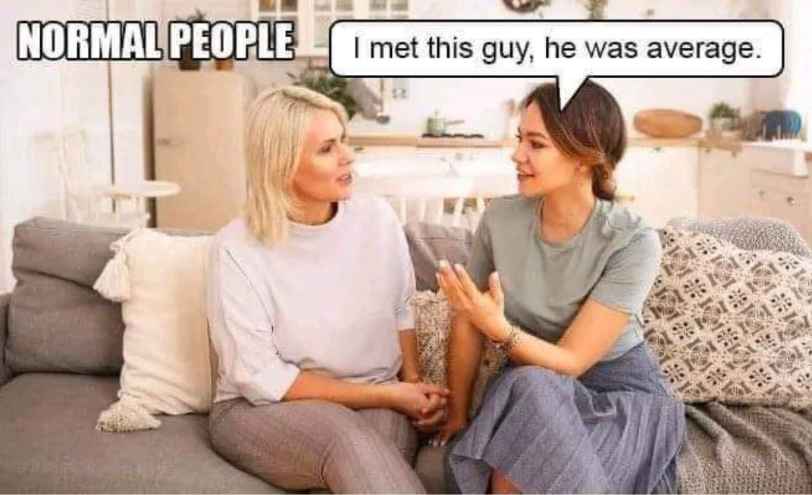
Skill 1. Paraphrasing (cont)
2. Be clear: Take confusion way and make it understandable

Slide 42
Skill 1. Paraphrasing (cont)
3. Be concise: get to the bare essentials
Example: The office wasn’t open at that point in time, owing to the fact that there was no electrical power in the building.
Paraphrase: The office was closed then because there was no electricity in the building.

Slide 43
Skill 1. Paraphrasing (cont)
4. Be charitable: Again, avoid straw man
Example: Cigarette smoking can cause lung cancer. Therefore, if you continue to smoke, you are endangering your health.
1. Cigarette smoking guarantees that you will get lung cancer. Continue to smoke and you’ll get health problems soon.
2. Cigarette smoking increases the risk of lung cancer. If you continue to smoke, you risk being unhealthy.
Comment: (1) changes the original meaning by making the situation more serious than it actually is; (2) is an accurate paraphrase.

Slide 44
Task: Choose the best paraphrase
Black Friday does not really offer discounted deals because many suppliers set extremely high prices and then “discount” them.
Which of the following is a good paraphrase?
Black Friday does not attract a large number of buyers because its prices are too high at the beginning.
Customers are not really interested in online sales on Black Friday because it sets cutting prices.
Due to many of its much higher initial prices, Black Friday is not a sales promotion indeed.
Many customers do not care about Black Friday because they put quality before prices.
Notes:
Answer: C

Slide 45
Skill 2. Finding missing premises and conclusions
People often leave premises or conclusions out of their arguments.
Identifying missing premises: If there isn’t enough support for the conclusion, determine what is needed to support the conclusion and insert it.
Example: ‘You’re under 21. Therefore, I can’t sell you beer.’
Missing major premise: ‘It is illegal to sell beer to those under 21.’
Or: ‘By law, I can’t sell beer to anyone under 21.’

Slide 46
Task: Find the missing (major/minor) premises or conclusion and insert them to make good arguments (deductively sound or inductively cogent)
a. I must register my course schedule for next Semester 1. I’m a fresher.
Missing major premise: According to IU policy, all freshers register their schedule for next Semester 1 when they reach their 2nd year.
b. IU has various clubs which develop soft skills. Soft skills are increasingly required by employers.
Missing conclusion: So, most IUers should join one of these clubs.
c. You can’t skip Quiz 3. It is indicated in the syllabus that students take three quizzes to be qualified for the final exam.
Missing minor premise: You just took Quiz 1 and Quiz 2.

Slide 47
Review: Summarizing extended arguments
Read carefully to identify the main conclusion (or if it is missing).
Omit unnecessary/irrelevant word(s)/statement(s).
Number the steps; put the conclusion first or last.
Fill in any missing premises or conclusions.

Slide 48
Summarizing extended arguments: What to avoid
1. Don’t write incomplete sentences
Error:
Because animals can experience pain and suffering. Therefore, it’s wrong to kill or mistreat animals.
Correct:
Animals can experience pain and suffering. Therefore, it’s wrong to kill or mistreat animals.
“I choose a lazy person to do a hard job. Because a lazy person will find an easy way to do it.” Bill Gates
“I choose a lazy person to do a hard job. This is because a lazy person will find an easy way to do it.” Bill Gates

Slide 49
Summarizing extended arguments: What to avoid
2. Don’t include more than one statement per line.
Error:
The CEO should resign since he no longer gains the confidence of the share holders.
Correct:
The CEO no longer gains the confidence of the share holders.
Therefore, the CEO should resign.

Slide 50
Summarizing extended arguments: What to avoid
3. Don’t include non-statements.
Error:
Trump and Biden are both American presidents, unlike me a Vietnamese.
So why should I care about American politics?
Correct:
Trump and Biden are both American presidents, but I’m a Vietnamese.
So I have no reason to care about American politics.

Slide 51
Summarizing extended arguments: What to avoid
4. Don’t include anything that is not a premise or a conclusion.
Error:
Critical thinking is both a professional and life skill.
All non-political courses at IU are taught in English.”
Critical Thinking is a non-political course.
Therefore, Critical Thinking is taught in English at IU.
(1) doesn’t support the conclusion, so leave it out of the standardized argument.

Slide 52
Practice: Standardize this argument
Professor Jack W. Meiland, offering advice to college students:
There is one question which you should not ask, nor feel any temptation to ask, your instructor. That question is: “Will this be on the exam?” This question infuriates many instructors, and rightly so. For this question indicates that your main interest is in getting through the course with a good grade rather than in learning what the instructor has to teach. It is insulting to the teacher who has worked hard to put you in a position to appreciate the material - its intrinsic interest, its subtlety, its complexity.

Slide 53
Standardized argument 1
Professor Jack W. Meiland, offering advice to college students:
(1)You should not ask your instructor about the exam contents. First, (2)your question indicates that you’re more interested in a good grade rather than in learning, so (3)it makes your instructor angry. Second, (4)this question is insulting to your instructor because (5)he/she has made great efforts to inspire you with the lesson.
2
5
3
4
1

Slide 54
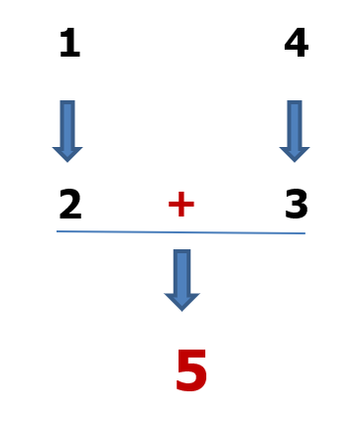
Standardized argument 2
Professor Jack W. Meiland, offering advice to college students:
(1) Your question about the exam contents indicates that you’re more interested in a good grade rather than in learning, so (2)it makes your instructor angry. (3)This question is also insulting to your instructor because (4)he/she has made great efforts to inspire you with the lesson. (5)For those reasons, you should not ask your instructor about the exam contents.

Slide 55
Practice: Standardize this argument
My opinion regarding the amount of homework a child receives is basically threefold. I don’t believe the children should receive any homework whatsoever. One, because the teacher has seven or eight hours during the course of the school day to instruct children and do assignments with them, to review material for tests. They do not need to be sending work home. To me, homework is an excuse for a teacher’s lack of ability to do their job properly. Two, there are too many children that come home with either no adult there or no adult with the ability to help them with their homework. That places too many children at a disadvantage compared to other children who have their parents there to help them with their homework. Three, an adult spends eight hours at work, comes home, and has the rest of the day to enjoy themselves. That is a luxury that a child should definitely be afforded. They don’t need to spend time after school. Teacher, it is time to wake up.

Slide 56
Standardized argument
Children should not be given any homework for three reasons. First, they work enough with their teachers in class for eight hours, so no more assignments or review materials are needed at home. Second, homework is an obstacle for too many children who have no adult relatives to help or unable to help. Third, like adults, children need a rest after 8 hours at school.

Slide 57
Assignment
Read the article in the following link
https://www.baogiaothong.vn/tp-thu-duc-co-16-tuyen-duong-ngap-do-mua-khu-vuc-nang-nhat-ngap-toi-06m-192240516182450327.htm
https://www.baogiaothong.vn/tp-thu-duc-co-16-tuyen-duong-ngap-do-mua-khu-vuc-nang-nhat-ngap-toi-06m-192240516182450327.htm
Task: Summarize a causal argument made by Thủ Đức city’s authorities about the local flooding on May 15, 2024 and diagram the argument. Use clear premise and conclusion indicators.
Link to submit:
https://forms.gle/eX2nkMNDCWEdW1D68
Note: Delete lesson slides; only keep the assignment slides.

Slide 58
Project Preparation
Assignment: Each group is required to select a video of + 3 minutes or a text (in English or Vietnamese) with controversial content. Preferences are given to most popular or recent content.
Specific tasks will be given next week.

Slide 59
THANK YOU

